Slide 1
Capstone Project Netflix movies and tv shows clustering
By- Ayush Ambhore

Slide 2
Points for discussion
Problem Statement
Data summary
Exploratory Data Analaysis
Feature Engineering and Data Pre-processing
ML model - I
ML model - II
Content-based Recommender System
Conclusion

Slide 3
Problem statement
The objective of this project is to cluster Netflix TV shows and movies based on their intrinsic features such as director, cast, country, genre, and description. By doing so, we aim to group similar shows together and identify distinct content patterns within the dataset. Through text clustering techniques, we aim to provide valuable insights into content distribution and user preferences on the Netflix platform, ultimately enhancing the user experience and content recommendations.

Slide 4
Data summary
show_id: An identifier or unique code for each show or movie in the dataset.
type: Indicates whether the entry is a "TV Show" or a "Movie".
title: The title or name of the TV show or movie.
director: The name of the director(s) or filmmaker(s) responsible for creating the content. This column is typically available for movies and may be empty or null for TV shows.
cast: The list of main actors or performers who are part of the show or movie.
country: The country or countries where the content was produced or originated from.
date_added: The date when the content was added to the Netflix catalog.
release_year: The year when the content was originally released (for movies) or first aired (for TV shows).
rating: The content rating assigned to the show or movie based on its suitability for different audiences (e.g., PG, PG-13, TV-MA, etc.).
duration: The duration or runtime of the content (e.g., 1 hour, 30 minutes).
listed_in: The category or genre under which the content is classified or listed on Netflix (e.g., Comedy, Action & Adventure, Sci-Fi & Fantasy).
description: A brief synopsis or summary of the plot or storyline of the show or movie.

Slide 5
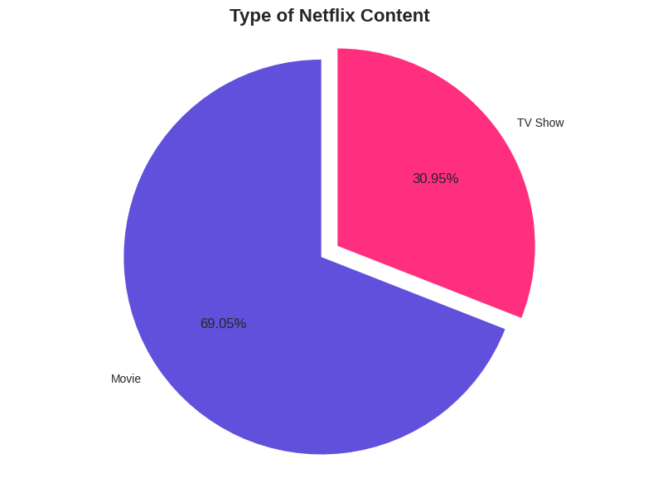
Exploratory Data analysis
Type of Netflix content
TV shows account for approximately 30.86% of the content on Netflix.
Movies make up the majority of the content with approximately 69.14%.

Slide 6
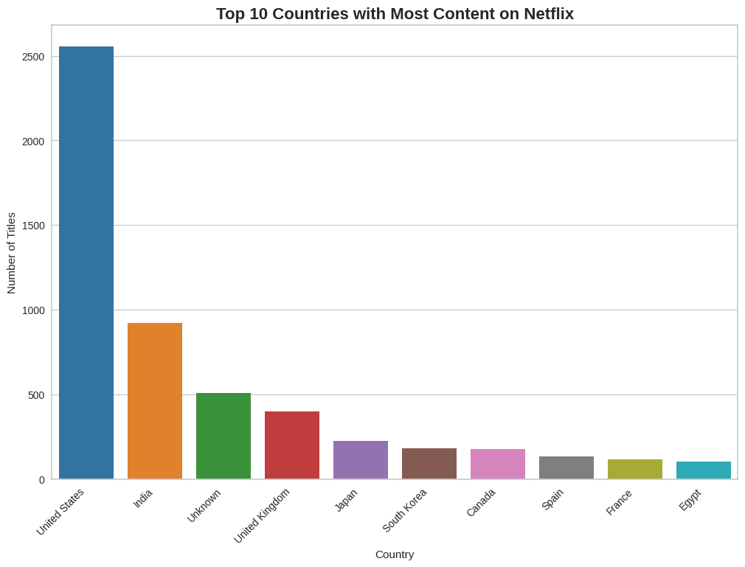
Top 10 countries with most content on netflix
The United States has the highest number of titles on Netflix, with more than 2500 titles.
India follows with around 1000 titles, which is significantly lower than the number of titles in the United States.
The United Kingdom and Japan also have a considerable number of titles, but they are still significantly lower than the number of titles in the United States.
Other countries have even fewer titles compared to the top countries mentioned above.

Slide 7
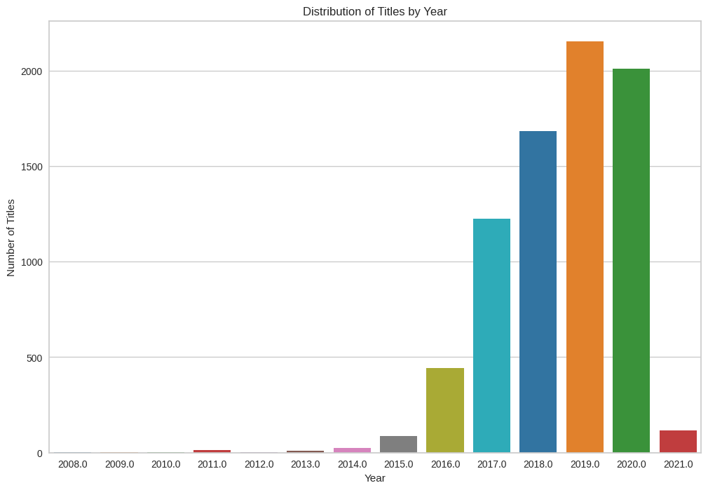
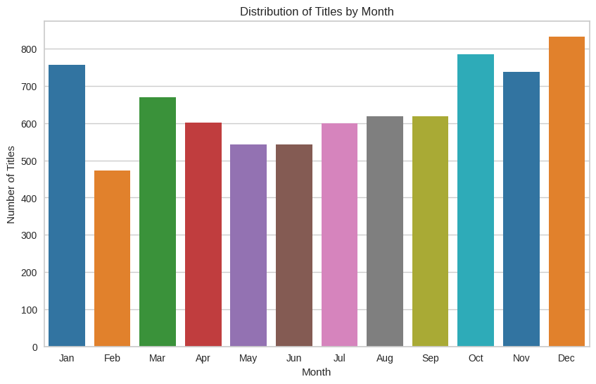
Distribution of titles by year and month
For Year: The plot shows that 2019 has the highest number of titles added to Netflix, with approximately 2000 titles. This is followed by 2020, which has slightly fewer titles than 2019. Additionally, the years 2018, 2017, and 2016 also have significant numbers of titles added. However, it's worth noting that the data may be incomplete for the current year (2023), as the plot does not show the full year's data.
For Month: The plot reveals that December has the highest number of title additions, with over 800 titles. Following December, October and January have the next highest number of title additions, with both months having around 750 titles added. These months seem to be peak periods for content additions.

Slide 8
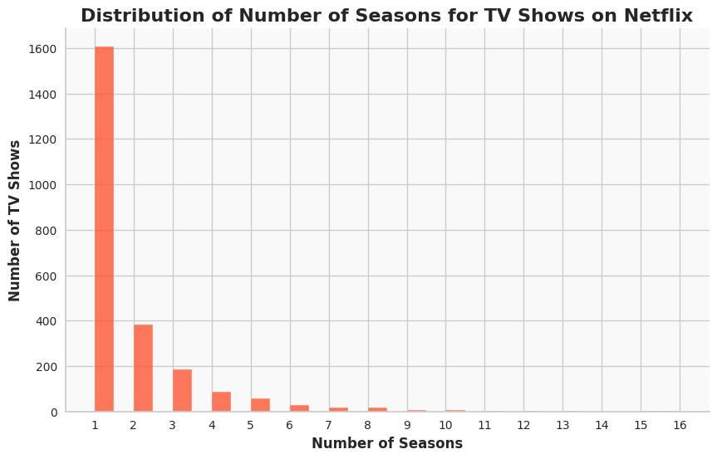
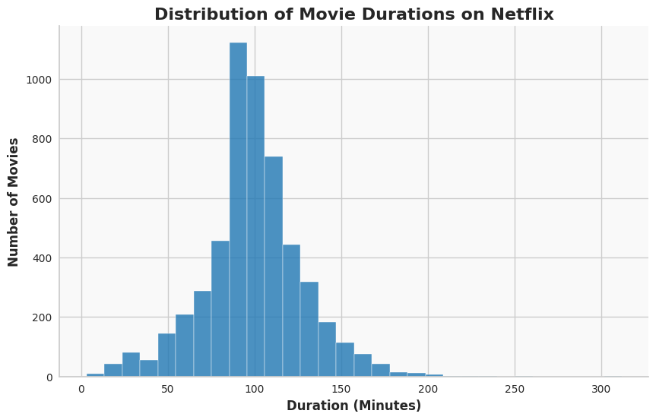
Distribution of number of seasons for tv shows and
Movie durations on netflix
For Movies:
The most common movie duration on Netflix is around 90 minutes, with more than 1000 titles falling into this duration category.
The second most common duration is approximately 100 minutes, with another 1000 titles falling into this category.
After that, the frequencies of movie durations decrease gradually for durations such as 110 minutes, 80 minutes, and so on
For TV Shows:
TV shows with only one season (Season 1) have the highest frequency, with around 1600 titles falling into this category.
As the season number increases, the frequency of TV shows decreases. This implies that there are fewer TV shows with higher numbers of seasons.

Slide 9
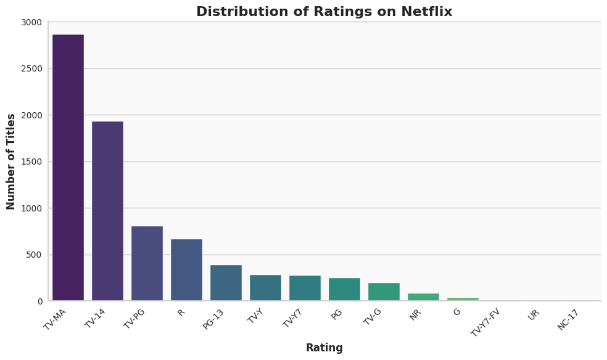
Distribution of ratings on netflix
The majority of titles on Netflix have the TV-MA rating, indicating that the content is intended for mature audiences and may contain explicit content.
The TV-14 rating comes in second, followed by TV-PG, R, and PG-13, with progressively lower numbers of titles.

Slide 10
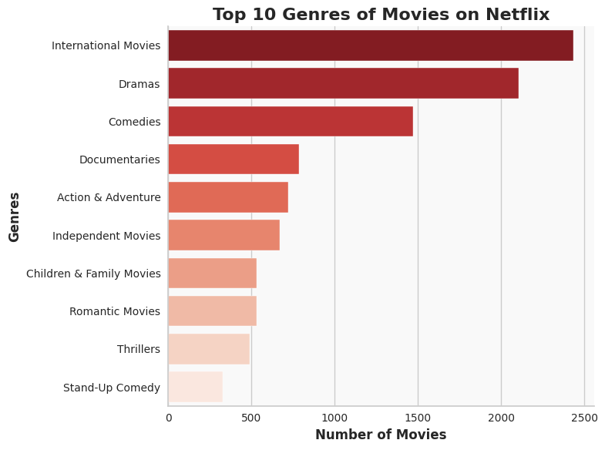
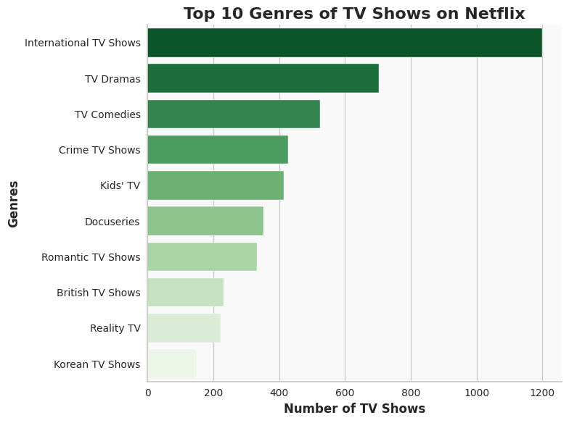
Top genres of movies and tv shows on netflix
From the bar plot for movies, we can observe that "International Movies" is the most common genre, followed by "Dramas," "Comedies," "Documentaries," etc. This suggests that international movies and drama content are quite popular on Netflix.
From the bar plot for TV shows, we can see that "International TV Shows" are the most common, followed by "TV Dramas," "TV Comedies," "Crime TV Shows," etc. This indicates that international TV shows and drama content are prominent among the TV shows available on Netflix.

Slide 11
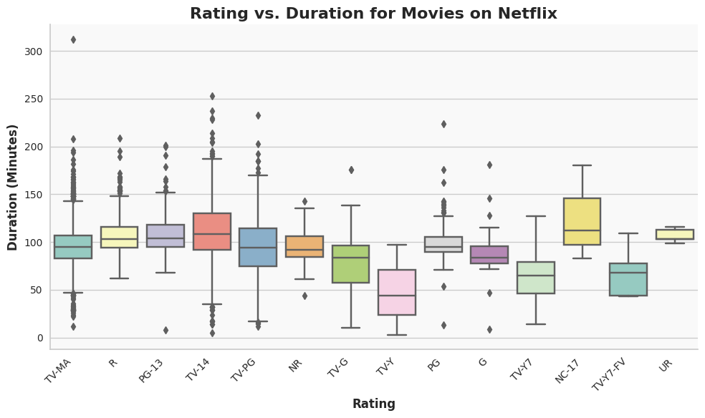
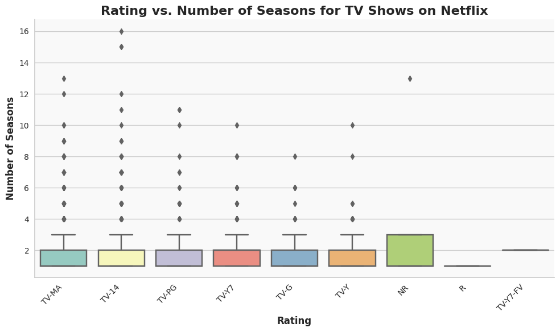
Rating vs Duration and seasons of movies and tv shows respectiveyly
Content creators can tailor their content based on rating preferences to target specific audiences.
Movies with higher ratings (e.g., TV-MA) tend to have longer durations, attracting viewers who prefer such content.
Understanding preferred durations for different rating categories can guide content planning and budget allocation.
This analysis helps content creators in producing relevant and well-received content.

Slide 12
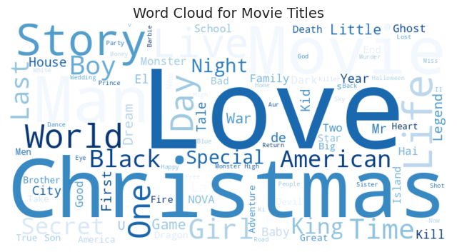
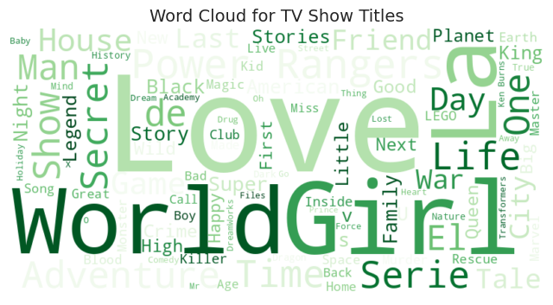
Word clouds for title
Insights from the word cloud for movie titles:
Most occurred words include: Christmas, love, movie, man, life
Insights from the word cloud for TV show titles:
Most occurred words include: Girl, world, love, LA.

Slide 13
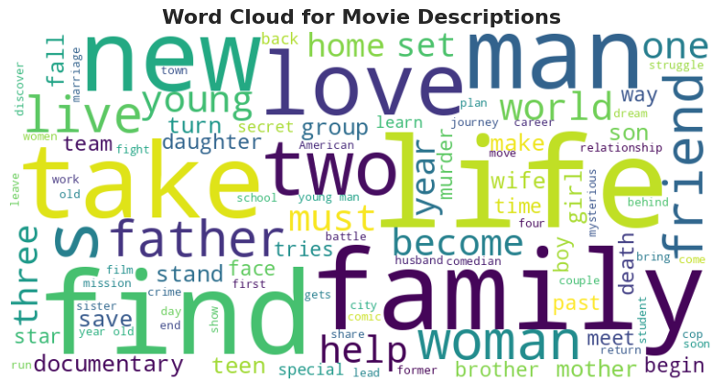
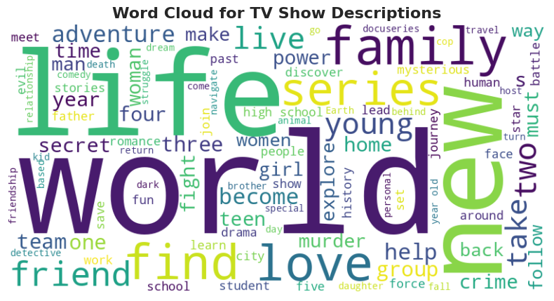
Word clouds for descriptions
From the word cloud for movie descriptions, we observed that words like "life," "find," "love," "family," "new," "woman," and "two" are the most frequently occurring words. These terms suggest that movies on Netflix may frequently revolve around themes related to life experiences, relationships, and new beginnings.
From the word cloud for TV show descriptions, we noticed that words like "life," "new," "world," "love," "live," "series," and "find" are the most frequently occurring words. This indicates that TV shows often feature themes related to various life aspects, exploration of new worlds, love stories, and ongoing series.

Slide 14
Feature Engineering & Data Pre-processing
Attribute selection: The 'cluster' column is created by concatenating relevant columns like 'director', 'cast', 'country', 'listed_in', and 'description' from the DataFrame 'df'.
Removing stop words: Eliminating common words that don't contribute much to the meaning of text data to reduce noise and focus on meaningful content.
Removing punctuation: Standardizing and simplifying text data by removing punctuation marks for further analysis and modeling.
Removing non-ASCII characters: Simplifying text data by removing special symbols and characters from other languages to facilitate natural language processing tasks.
Lemmatization: Reducing words to their base form for better text analysis and improved search and retrieval systems.
Tokenization: Breaking down text into individual units (tokens) to enable efficient text processing and analysis.
Vectorization: Converting text data into numerical vectors for effective processing and analysis by machine learning algorithms.
Dimensionality reduction: Using PCA to reduce the number of features in the dataset, simplifying computations and improving model performance.

Slide 15
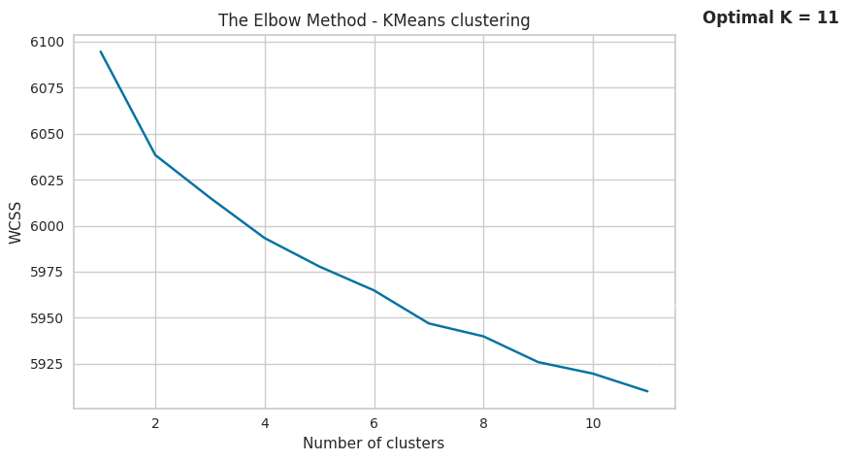
Model 1: K-Means Clustering
The elbow method
The elbow method graph shows a decreasing trend of Within-Cluster Sum of Squares (WCSS) as the number of clusters increases.
There is no clear "elbow" point where the graph exhibits a significant change in slope or a sharp bend.
This indicates that the optimal number of clusters is not evident from the graph alone.
Without a distinct elbow point, it becomes challenging to determine the most appropriate number of clusters for the KMeans model.

Slide 16
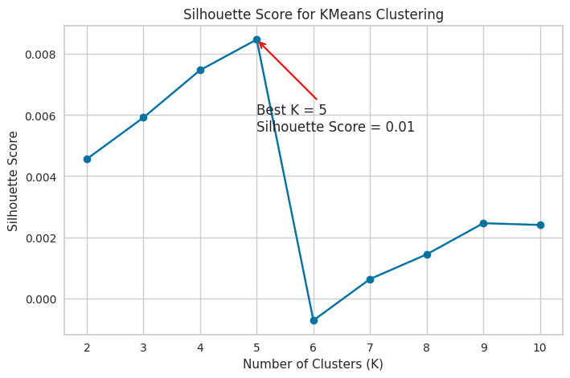
Silhouette score
The Silhouette score measures how well the data points are clustered. A score of 0.01 indicates that the clusters have some overlapping data points, but it's still better than having negative values.
The best k value for KMeans clustering with a Silhouette score of 0.01 is 5. It suggests that the data is moderately well-clustered into five distinct groups.

Slide 17
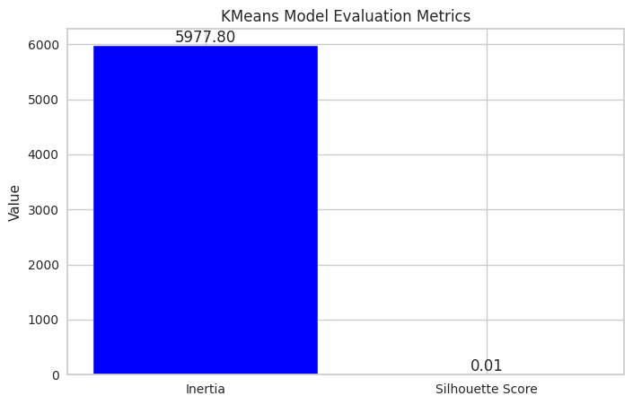
Evaluation metrics for kmeans
Inertia: Measures how tightly the data points are clustered around their centroids. Lower inertia is better as it indicates more compact and well-separated clusters.
Silhouette Score: Assesses the quality of clustering. A higher score (closer to 1) indicates well-defined clusters, while a score closer to 0 suggests overlapping or less distinct clusters.

Slide 18
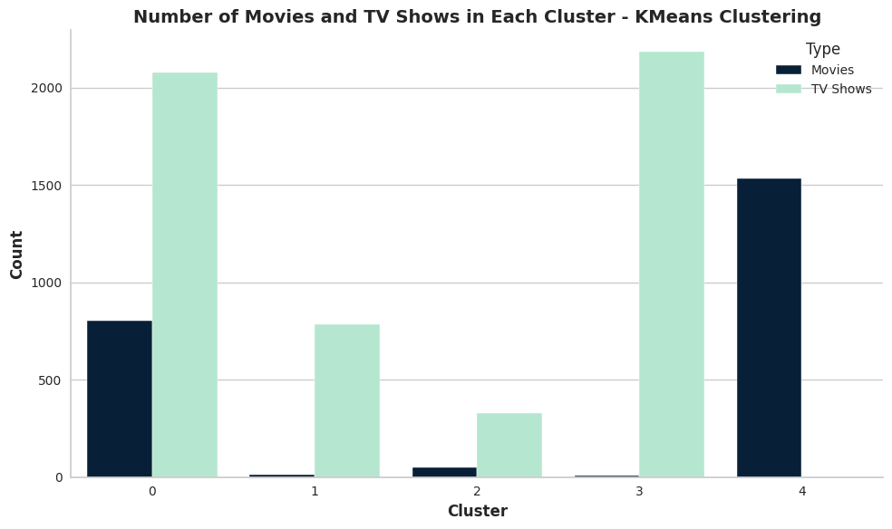
Number of movies and tv shows in each cluster – Kmeans clustering
KMeans clustering resulted in five clusters for Netflix content.
Cluster 0: Around 800 movies and over 2000 TV shows.
Cluster 1: Approximately 10 movies and about 800 TV shows.
Cluster 2: About 40 movies and around 350 TV shows.
Cluster 3: Only 2 movies and over 2200 TV shows.
Cluster 4: Above 1500 movies and no TV shows.
Clusters demonstrate varying distributions of movies and TV shows.
Successful separation based on content similarities.

Slide 19
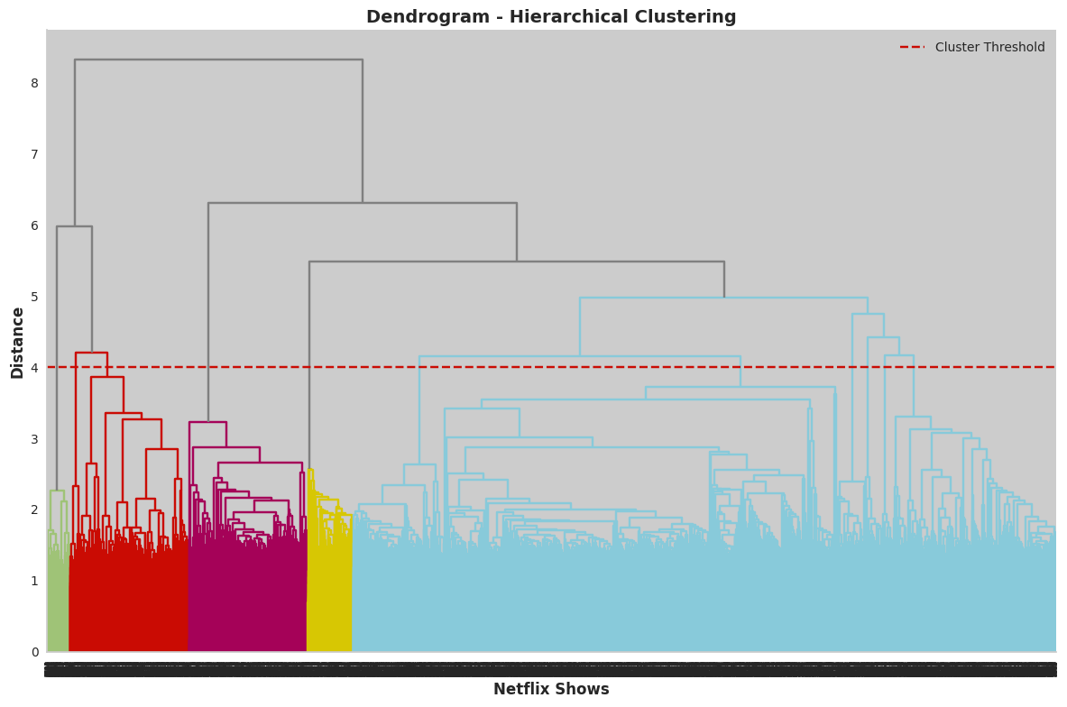
Model 1I: HierArchical Clustering
Dendrogram
Agglomerative clustering forms 11 clusters with a distance threshold of 4 units.
It utilizes PCA-transformed data and the Ward linkage method with Euclidean distance.
The hierarchical_clusters array holds predicted cluster assignments for each data point.
Clusters represent shows with similar characteristics based on their features.

Slide 20
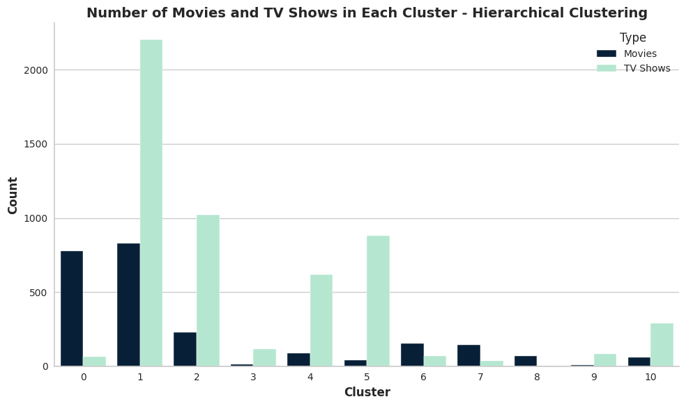
Number of movies and tv shows in each cluster – Hierarchical clustering
Hierarchical clustering groups movies and TV shows into 11 clusters based on feature similarities.
Each cluster represents a distinct group with specific characteristics or patterns.
Insights into different genres or content types can be gained from the clustering.
The method provides valuable information on content categorization and preferences.

Slide 21
Content-based Recommender System
Content-based Recommender System: Utilizes intrinsic features and attributes of items for personalized recommendations.
Data Preprocessing: Changes DataFrame index to show title and converts tokenized clusters to strings.
Vectorization: Uses CountVectorizer to transform text data into a numerical representation.
Cosine Similarity: Measures item similarity based on their feature vectors.
Recommendation Function: 'recommend_top10' generates top 10 show recommendations.
Personalized Recommendations: Successfully suggests related shows for specific titles like 'Friends,' 'Breaking Bad,' and 'Kal Ho Naa Ho.'

Slide 22
Conclusion
Goal: Categorize Netflix shows into clusters for similarity within and dissimilarity between clusters.
Data Preprocessing: Addressed missing values, filled based on relevant info, and removed records with null "date_added."
Content Distribution: 31% TV shows, 69% movies, with TV-MA as the most common rating.
Library Expansion: More movies added in 2017-2018, more TV shows in 2019-2020.
Seasonal Trends: Higher content additions during Christmas and winter months.
Popular Genres: Documentaries, stand-up comedy, dramas, foreign films for movies, kids' shows for TV.
Duration: Movies mostly 90-120 mins, TV shows with single seasons.
Top Content Producers: USA and India.
Clustering Approach: Used director, cast, country, genre, and description attributes, applied TFIDF vectorization, and PCA for dimensionality reduction.
Optimal Clusters: K-means (6 clusters) and Agglomerative (12 clusters) based on elbow method and Silhouette score.
Recommender System: Content-based with cosine similarity on similarity matrix for personalized 10 show recommendations.
Model Advantages: Personalized suggestions without user interactions or historical data.
Insights for Creators: Understanding viewer preferences and content trends for targeted productions.
Future Work: Integrating external datasets, advanced text embeddings, and evaluating model performance with additional metrics.

Slide 23
Thankyou

